Slide 1
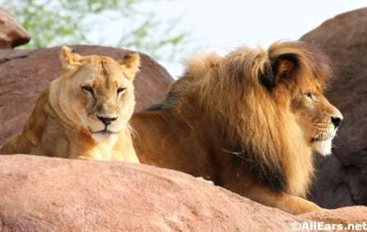
ANIMAL KINGDOM
RAJESWARI
PGT BIOLOGY

Slide 2
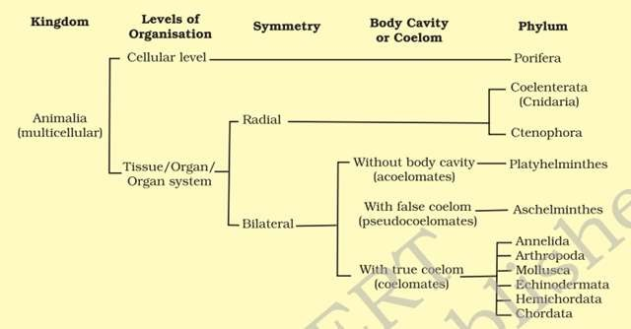
BASIS OF CLASSIFICATION

Slide 3
LEVELS OF ORGANISATION
Cellular level of organization – Sponge
Tissue level
Organ level
Organ system level
Digestive system in Platyhelminthes has only a single opening to the outside of the body that serves as both mouth and anus, and is hence called incomplete. A complete digestive system has two openings, mouth and anus.
Circulatory system may be of two types:
Open type in which the blood is pumped out of the heart and the cells and tissues are directly bathed in it and
Closed type in which the blood is circulated through a series of vessels of varying diameters (arteries, veins and capillaries).

Slide 4
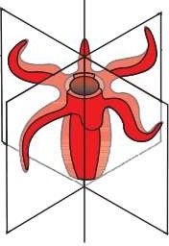
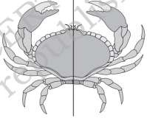
SYMMETRY
 Asymmetrical - any plane that passes through the centre does not divide them into equal halves. Ex. Sponges
Radial symmetry
Radial symmetry -When any plane passing through the central axis of the body divides the organism into two identical halvesEx. Coelenterates, ctenophores and echinoderms have this kind of body plan.
Bilateral symmetry
Bilateral symmetry - Animals like annelids, arthropods, etc., where the body can be divided into identical left and right halves in only one plane, exhibit

Slide 5
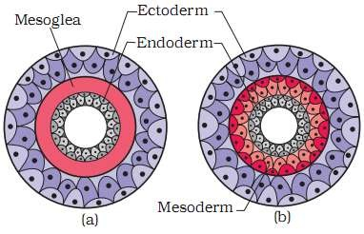
Diploblastic and Triploblastic Organisation
Diploblastic animals - Animals in which the cells are arranged in two embryonic layers, an external ectoderm and an internal endoderm, e.g., coelenterates.
An undifferentiated layer, mesoglea, is present in between the ectoderm and the endoderm.
Triploblastic animals - Those animals in which the developing embryo has a third germinal layer, mesoderm, in between the ectoderm and endoderm.e.g. (platyhelminthes to chordates
(a) Diploblastic (b) Triploblastic

Slide 6
COELOM
 The body cavity, which is lined by mesoderm is called coelom.
Animals possessing coelom are called coelomates, e.g., annelids, molluscs, arthropods, echinoderms, hemichordates and chordates .
In some animals, the body cavity is not lined by mesoderm, instead, the mesoderm is present as scattered pouches in between the ectoderm and endoderm. Such a body cavity is called pseudocoelom and the animals possessing them are called pseudocoelomates, e.g., aschelminthes .
The animals in which the body cavity is absent are called acoelomates, e.g., platyhelminthes .

Slide 7
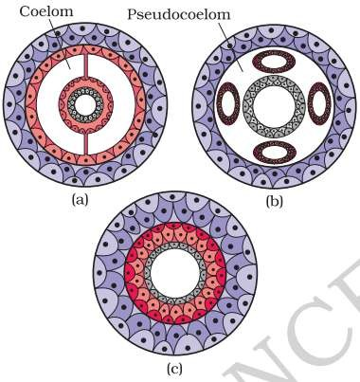
sectional view of : (a) Coelomate (b) Pseudocoelomate (c) Acoelomate

Slide 8
SEGMENTATION
In some animals, the body is externally and internally divided into segments with a serial repetition of at least some organs. For example, in earthworm, the body shows this pattern called metameric segmentation and the phenomenon is known
as metamerism.
NOTOCHORD
Notochord is a mesodermally derived rod-like structure formed on the dorsal side during embryonic development in some animals. Animals with notochord are called chordates and those animals which do not form this structure are called non-chordates, e.g., porifera to echinoderms

Slide 9
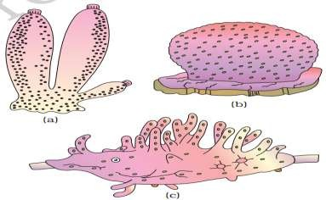
PHYLUM – PORIFERA
commonly known as sponges
asymmetrical animals
Sponges have a water transport or canal system
Digestion is intracellular.
Sexes are not separate (hermaphrodite)
Examples: Sycon (Scypha), Spongilla (Fresh water sponge) and Euspongia (Bath sponge).
Examples of Porifera : (a) Sycon (b) Euspongia (c) Spongilla

Slide 10
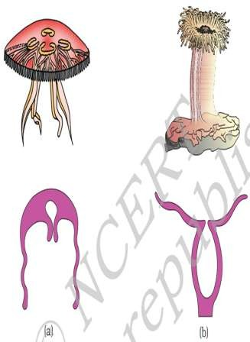

PHYLUM – COELENTERATA (CNIDARIA)
 They are aquatic, mostly marine,
radially
sessile or free-swimming,
symmetrical animals
The name cnidaria is derived from the cnidoblasts or cnidocytes (which contain the stinging capsules or nematocytes) present on the tentacles and the body. Cnidoblasts are used for anchorage, defense and for the capture of prey.
tissue level of organisation and are diploblastic
Digestion is extracellular and intracellular
Cnidarians exhibit two basic body forms called polyp and medusa
Examples of Coelenterata indicating outline of their body form : (a) Aurelia (Medusa) (b) Adamsia (Polyp)
Diagrammatic view of Cnidoblast

Slide 11
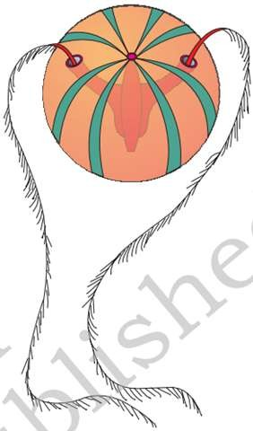
PHYLUM – CTENOPHORA
 Ctenophores, commonly known as sea walnuts or comb jellies are exclusively marine, radially symmetrical, diploblastic organisms with tissue level of organisation.
 The
rows
body bears
of ciliated
eight
comb
external
plates,
which help in locomotion.
 Bioluminescence (the property of a living organism to emit light) is well-marked in ctenophores.
Sexes are not separate.
Example of Ctenophora (Pleurobrachia

Slide 12
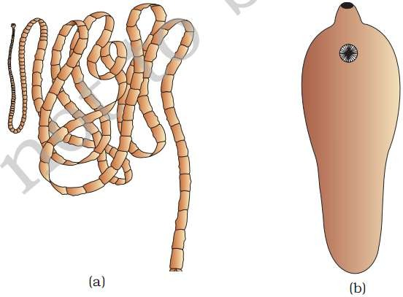
PHYLUM – PLATYHELMINTHES
They have dorso-ventrally flattened body, hence are called flatworms .
These are mostly endoparasites found in animals including human beings.
Flatworms are bilaterally symmetrical, triploblastic and acoelomate animals with organ level of organisation.
Hooks and suckers are present in the parasitic forms. Fertilisation is internal and development is through many larval stages
Examples of Platyhelminthes : (a) Tape worm (b) Liver fluke

Slide 13
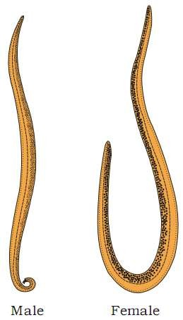
PHYLUM – ASCHELMINTHES
The body of the aschelminthes is circular in cross-section, hence, the name roundworms.
Roundworms have organ-system level
of body
organisation. They are symmetrical, triploblastic
bilaterally
and pseudocoelomate animals.
 . Sexes are separate (dioecious). Often females are longer than males.
 Fertilisation development
is internal and may be direct (the
young ones resemble the adult) or indirect.
Aschelminthes – Roundworm

Slide 14
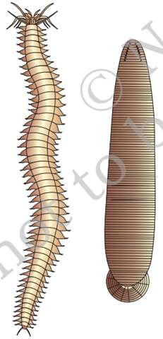
Phylum – Annelida
They may be aquatic (marine and fresh water) or terrestrial; free-living, and sometimes parasitic.
Exhibit organ-system level of body organisation and bilateral symmetry.
Triploblastic, metamerically segmented and coelomate animals.
Their body surface is distinctly marked out into segments or metameres and, hence, the phylum name Annelida
A closed circulatory system is present.
Nephridia (sing. nephridium) help in osmoregulation and excretion
Nereis, an aquatic form, is dioecious, but earthworms and leeches are monoecious
Examples of Annelida : (a) Nereis (b) Hirudinaria

Slide 15
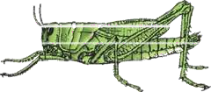
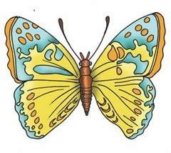
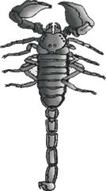
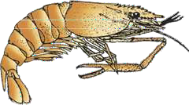
PHYLUM – ARTHROPODA
This is the largest phylum of Animalia which includes insects. Over two-thirds of all named species on earth are arthropods
organ-system level of organisation. They are bilaterally symmetrical, triploblastic, segmented and coelomate animals
covered by chitinous exoskeleton
They have jointed appendages (arthros- joint, poda-appendages).
Sensory organs like antennae, eyes (compound and simple), statocysts or balance organs are present.
Excretion takes place throughmalpighian tubules. They are mostly dioecious
Fertilisation is usually internal.
They are mostly oviparous.
Examples of Arthropoda : (a) Locust (b) Butterfly
Development may be direct or indirect.
(c) Scorpion (d) Prawn

Slide 16
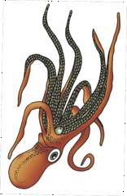
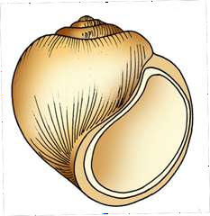
PHYLUM – MOLLUSCA
This is the second largest animal phylum
Molluscs are terrestrial or aquatic (marine or fresh water) having an organ-system level of organisation.
They are bilaterally symmetrical, triploblastic and coelomate animals. Body is covered by a calcareous shell and is unsegmented with a distinct head, muscular foot and visceral hump.
A soft and spongy layer of skin forms a mantle over the visceral hump.
They are usually dioecious and
oviparous with indirect development
Examples of Mollusca : (a) Pila
(b) Octopus

Slide 17
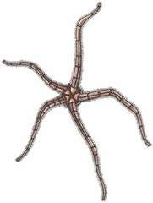
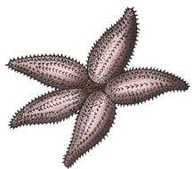
PHYLUM – ECHINODERMATA
These animals have an endoskeleton of calcareous ossicles and, hence, the name Echinodermata (Spiny bodied,
The adult echinoderms are radially symmetrical but
larvae are bilaterally symmetrical.
They are triploblastic and coelomate animals.
Digestive system is complete.
The most distinctive feature of echinoderms is the presence of water vascular system which helps in locomotion, capture and transport of food and respiration
An excretory system is absent.
Sexes are separate.
Reproduction is sexual.


Fertilisation is usually external.
Development is indirect with free-swimming larva
Examples of Echinodermata : (a) Asterias
(b) Ophiura

Slide 18

PHYLUM – HEMICHORDATA
Hemichordata was earlier considered as a sub-phylum under phylum Chordata. But now it is placed as a separate phylum under non-chordata
The body is cylindrical and is composed of an anterior proboscis, a collar and a long trunk .
Circulatory system is of open type.
Respiration takes place through gills.
Excretory organ is proboscis gland.
Sexes are separate.
Fertilisation is external.
Development is indirect.
Balanoglossus

Slide 19
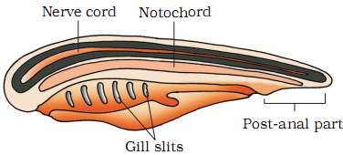
PHYLUM – CHORDATA
Animals belonging to phylum Chordata are fundamentally characterised by the presence of a notochord, a dorsal hollow nerve cord and paired pharyngeal gill slits .
These are bilaterally symmetrical, triploblastic, coelomate with organ-system level of organisation.
They possess a post anal tail and a closed circulatory system.
Chordata characteristics

Slide 20
Comparison of Chordates and Non-chordates
Chordates
Notochord present
Central nervous system is dorsal, hollow and single
Pharynx perforated by gill slits.
Heart is ventral.
A post-anal part (tail) is present.
Non-chordates
Notochord absent
Central nervous system is ventral, solid and double.
Gill slits are absent.
Heart is dorsal (if present).
Post-anal tail is absent.

Slide 21
Phylum Chordata is divided into three subphyla:
Urochordata or Tunicata ,
Cephalochordata
and Vertebrata.
Subphyla Urochordata and Cephalochordata are often referred to as protochordates and are exclusively marine.
In Urochordata, notochord is present only in larval tail, while in Cephalochordata, it extends from head to tail region and is persistent throughout their life.

Slide 22
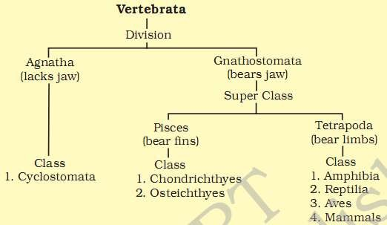
Subphylum Vertebrata
 The members of subphylum
notochord
Vertebrata possess
during the embryonic period.
The notochord is replaced by a cartilaginous or bony vertebral column in the adult.
Thus all vertebrates are chordates but all chordates are not vertebrates.

Slide 23
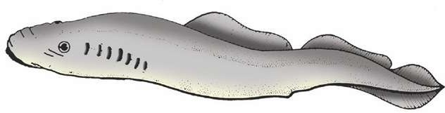
CLASS – CYCLOSTOMATA
All living members of the class Cyclostomata are ectoparasites on some fishes.
They have an elongated body bearing 6-15 pairs of gill slits for respiration.
Cyclostomes have a sucking and circular mouth without jaws
Their body is devoid of scales and paired fins.
Cranium and vertebral column are cartilaginous.
Circulation is of closed type.
A jawless vertebrate – Petromyzon

Slide 24


CLASS – CHONDRICHTHYES
They are marine animals with streamlined body and have cartilaginous endoskeleton .
Mouth is located ventrally.
Notochord is persistent throughout life.
Gill slits are separate and without operculum (gill cover).
The skin is tough, containing minute placoid scales.
Teeth are modified placoid scales which are backwardly directed.
Their jaws are very powerful.
Due to the absence of air bladder, they have to swim constantly to avoid sinking.
Heart is two-chambered (one auricle and one ventricle). Some of them have electric organs (e.g., Torpedo) and some possess poison sting (e.g., Trygon). They are cold- blooded (poikilothermous) animals
Sexes are separate.
They have internal fertilisation and many of them are viviparous
Example of Cartilaginous fishes : (a) Scoliodon (b) Pristis

Slide 25
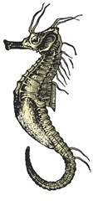

CLASS – OSTEICHTHYES
It includes both marine and fresh water fishes with bony endoskeleton.
Their body is streamlined.
Mouth is mostly terminal .
They have four pairs of gills which are covered by an operculum on each side.
Skin is covered with cycloid/ctenoid scales.
Air bladder is present which regulates
buoyancy.
Heart is two-chambered (one auricle and
one ventricle).
They are cold-blooded animals.
Sexes are separate.
Fertilisation is usually external.
They are mostly oviparous and development is direct.
Examples of Bony fishes : (a) Hippocampus (b) Catla

Slide 26
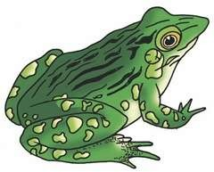
CLASS – AMPHIBIA
As the name indicates (Gr., Amphi : dual, bios, life), amphibians can live in aquatic as well as terrestrial habitats Most of them have two pairs of limbs.
Body is divisible into head and trunk.
Tail may be present in some.
The amphibian skin is moist (without scales).
The eyes have eyelids.
A tympanum represents the ear.
Alimentary canal, urinary and reproductive tracts open into a common
chamber called cloaca which opens to the exterior.
Respiration is by gills, lungs and through skin.
The heart is three- chambered (two auricles and one ventricle).
These are cold-blooded animals.
Sexes are separate.
Fertilisation is external.
They are oviparous and development is indirect.
Examples of Amphibia : (a) Salamandra (b) Rana

Slide 27
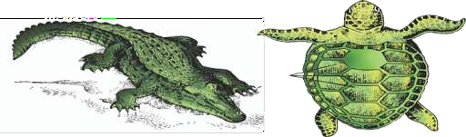
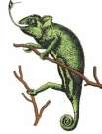
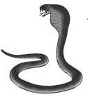
CLASS – REPTILIA
The class name refers to their creeping or crawling mode of locomotion (Latin, repere or reptum, to creep or crawl).They are mostly terrestrial animals and their body is covered by dry and cornified skin, epidermal scales or scutes .
They do not have external ear openings.
Tympanum represents ear. Limbs, when present, are two pairs.
Heart is usually three-chambered, but four-chambered in crocodiles. Reptiles are poikilotherms.
Snakes and lizards shed their scales as skin cast.
Sexes are separate. Fertilisation is internal.
They are oviparous and development is direct
Reptiles : (a) Chameleon (b) Crocodilus (c) Chelone (d) Naja

Slide 28
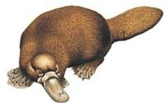
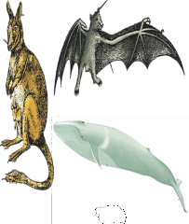
CLASS – MAMMALIA
They are found in a variety of habitats – polar ice caps, deserts, mountains, forests, grasslands and dark caves. Some of them have adapted to fly or live in water.
The most unique mammalian characteristic is the presence of milk producing glands (mammary glands) by which the young ones are nourished.
They have two pairs of limbs, adapted for walking, running, climbing, burrowing, swimming or flying
The skin of mammals is unique in possessing hair.
External ears or pinnae are present.
Different types of teeth are present in the jaw.
Heart is four- chambered.
They are homoiothermous. Respiration is by lungs. Sexes are separate and fertilisation is internal. They are viviparous with few exceptions and development is direct.
Some mammals : (a) Ornithorhynchus (b) Macropus (c) Pteropus (d) Balaenoptera

Slide 29
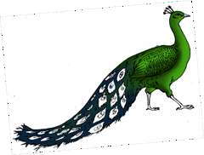
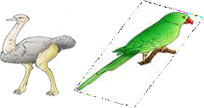
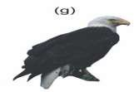
CLASS – AVES
The characteristic features of Aves (birds) are the presence of feathers and most of them can fly except flightless birds (e.g., Ostrich).
They possess beak
The forelimbs are modified into wings.
The hind limbs generally have scales and are modified for walking, swimming or clasping the tree branches.
Skin is dry without glands except the oil gland at the base of the tail. Endoskeleton is fully ossified (bony) and the long bones are hollow with air cavities (pneumatic).
Heart is completely four- chambered.
They are warm-blooded (homoiothermous) animals, i.e., they are able to maintain a constant body temperature.
Respiration is by lungs. Air sacs connected to lungs supplement respiration. Sexes are separate.
Fertilisation is internal. They are oviparous and development is direct.
Some birds : (a) Neophron (b) Struthio (c) Psittacula (d) Pavo

